Slide 1
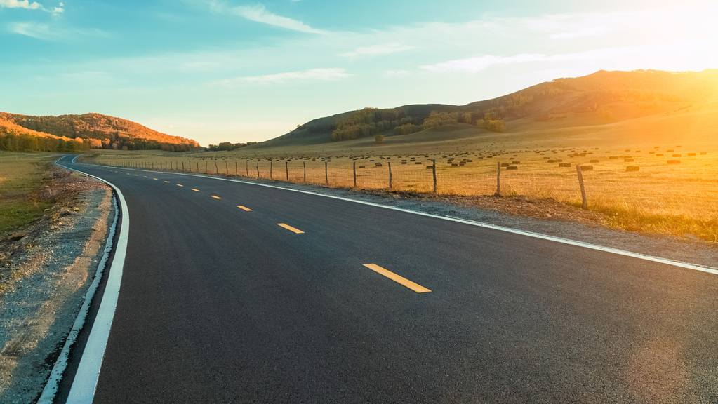

Accident Locations on Indian Roads
Team Name : Syndicate
Number of members: 1
Author: Justin Joseph
Intel Unnati Training Program

Slide 2
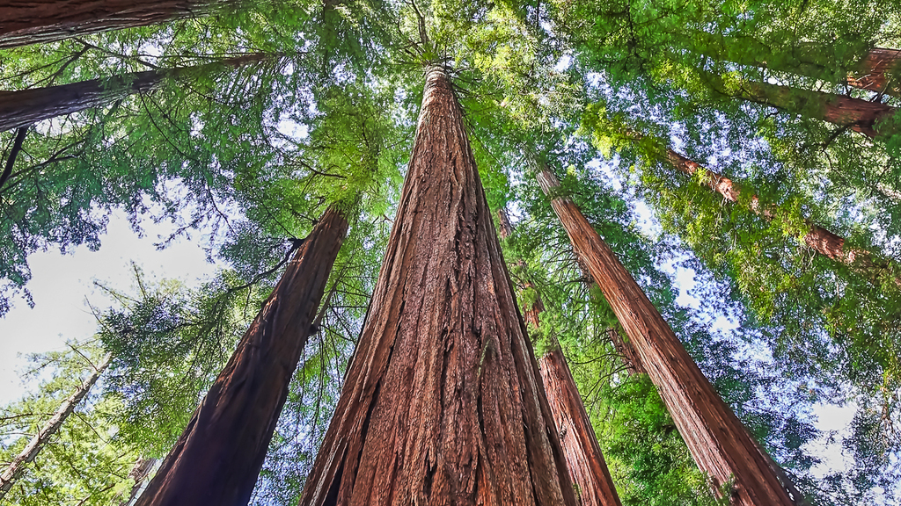
Project analysis
The aim of the project is to Identify the Blackspots in a selected region for reference and develop a map using GIS software and plot the identified Blackspots and the nearby Hospitals and Dispensaries in order to be approached in case of an untoward incident on the road.
The initial analysis reveals that the driver is the most unpredictable factor which lead to be cause of 80% of road accidents. The causes may be dizziness, over speeding, rash driving etc. The remaining portion accounts in for poor road conditions i.e., potholes, flooding, improper lighting etc.
Therefore, road safety is an important aspect to be focused for our own as well the safety of other drivers on the road. Hence, car manufactures and The Road Ministry are improving safety standards in vehicles and developing facilities around highways for traumatic care and assistance in case of an accident.

Slide 3
Approach
The area chosen for this is Bhopal City. It’s the capital of the state of Madhya Pradesh, the heart of India. According to recent news reports, a road accident occurs every 8 minutes in Bhopal. This makes it a matter of concern of the citizens as well as the authorities in order to ensure the safety standards on city roads.
This problem has been approached by plotting of Blackspots on the city roads and the nearby hospitals which can be used as reference by the public as well as the authorities to take required steps to eradicate the situation.
The data acquired is sourced from various platforms across the web such as news articles, Ministry of Transport, Police Reports etc.

Slide 4
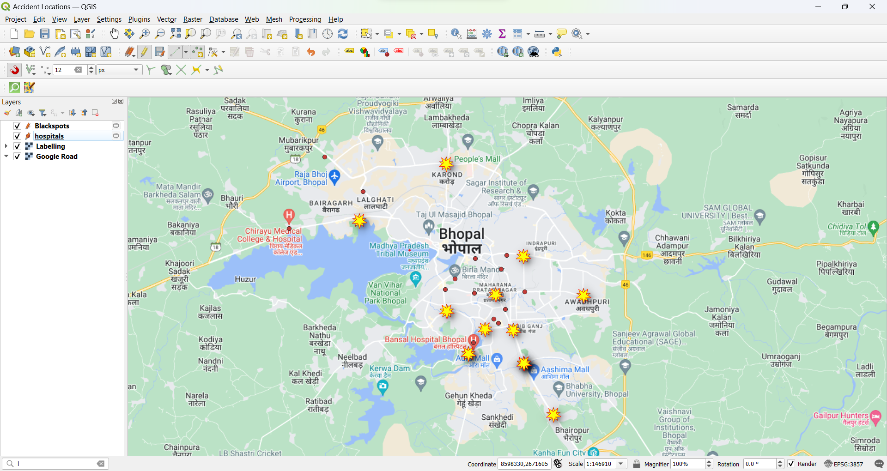
Legend: Red Spots: Hospitals Yellow labels: Blackspots

Slide 5
GitHub Link : https://github.com/juzztin-github/Intel-Unnati-Program-.git
References
News Articles:
https://timesofindia.indiatimes.com/city/bhopal/8-accidents/day-in-state-capital/articleshow/99654558.cms?from=mdr
https://www.hindustantimes.com/bhopal/19-black-spots-on-bhopal-roads-await-pwd-bmc-action/story-ihs8Zq0Lca9xGPoNsJ4ERI.html
Government Data:
https://morth.nic.in/sites/default/files/Madhya_Pradesh.pdf

Slide 6
summary
Road accidents have become very common nowadays. As more and people are buying automobiles, the incidences of road accidents are just increasing day by day. Furthermore, people have also become more careless now. Not many people follow the traffic rules. Especially in big cities, there are various modes of transports. Moreover, the roads are becoming narrower and the cities have become more populated.
Thus, road accidents are bound to happen. You pick up a newspaper and you will find at least one or two news about road accidents daily. They cause loss of life as well as material. People need to be more careful when on the road, no matter which mode of transport you are from. Even the ones on foot are not safe because of the rise in these incidences. Every day people witness accidents in the news, from relatives and even with their own eyes.
Therefore, a thorough analysis over the situation and developing project would be a benefit for the public as well as the authorities. Such projects are a training for skillset in not just computer science, but can bring about a change in the ground-level conditions of the area.

Slide 7
THANK YOU

